Slide 1

SCHOOL OF COMPUTER ENGINEERING AND TECHNOLOGY
CN Active Learning
Green Cloud Computing
Group Number : 2
Group Members:
Neeraj Varma PA-08 1032210651
Nishad Wanjari PA-09 1032210680
Naman Soni PA-10 1032210715
Vedang Phadke PA-07 1032210634
Archit Shikare PA-06 1032210629
Guided By: Prof. Lalit Kulkarni

Slide 2

Contents
What is Cloud Computing ?
The Impact of Cloud Computing
Green Cloud : Performance and Efficiency
Green Cloud Computing Architecture
Conclusion
References
Green Cloud Simulator : A promising alternative

Slide 3


What is Cloud Computing ?
Cloud computing is the on-demand delivery of IT resources over the Internet with pay-as-you-go pricing
Instead of buying, owning, and maintaining physical data centers and servers, you can access technology services, such as computing power, storage, and databases, on an as-needed basis from a cloud provider

Slide 4
The Impact of Cloud Computing
Virtualized
Dynamic And Distributed
Pay-as -you go
Elastic
Shared
Contributes to 2% of the world’s emissions
Power consumption has doubled since the year 2000
Datacentres consume an average of 200 TWh per year !

Slide 5
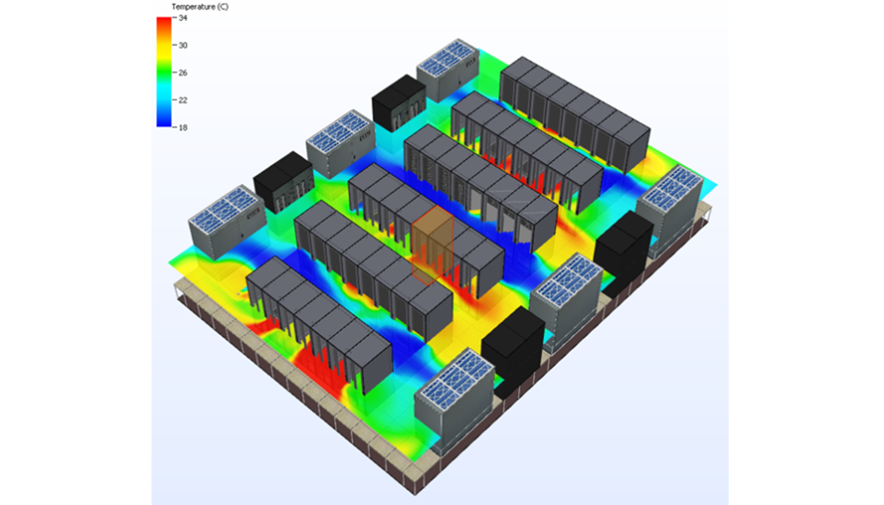
Where does the power go ?
Power Consumption in a Datacentre

Slide 6
Green Cloud : Performance and Efficiency
As energy costs are increasing , there is a need to shift focus from optimising data centre resource management for pure performance alone to optimising for energy efficiency while maintaining high service level performance
Thus we propose a Green Cloud Computing model that achieves not only efficient processing and utilization of computing infrastructure , but also minimise energy consumption

Slide 7
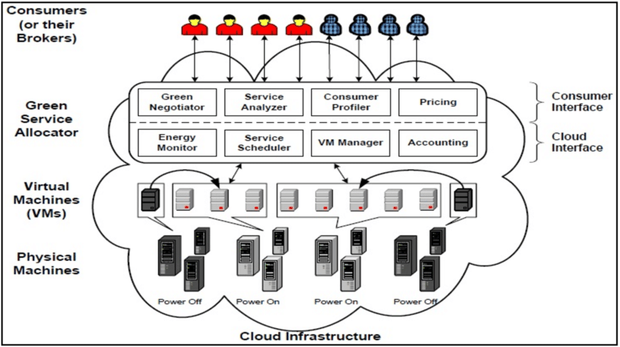
Green Cloud Architecture

Slide 8
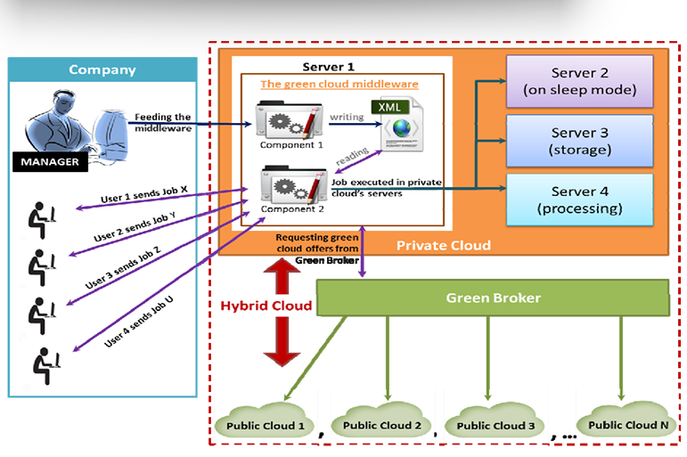

Slide 9
How does a Green Cloud work ?
Energy Source : The provider uses renewable energy as much as possible to power its data centers. This often includes wind or solar energy, along with large battery banks for storing the collected energy
Facility : The provider takes measures to use energy more efficiently in its data centers. For example, a provider might locate a data center in a cold climate, underground or even on the ocean floor. The provider might also find ways to utilize the excess heat generated in the data centers, such as warming nearby buildings

Slide 10
Infrastructure : The provider optimizes the hardware and software infrastructure. For example, a provider might deploy hardware that consumes less energy or use strategies such as dynamic voltage and frequency scaling (DVFS) to reduce power consumption
Workflow : The provider uses multiple strategies to optimize workflows at every level. This might include shifting workloads to different times, modifying applications to reduce network traffic, optimizing storage and server caches, automating routine tasks or taking any number of other steps to reduce energy usage

Slide 11
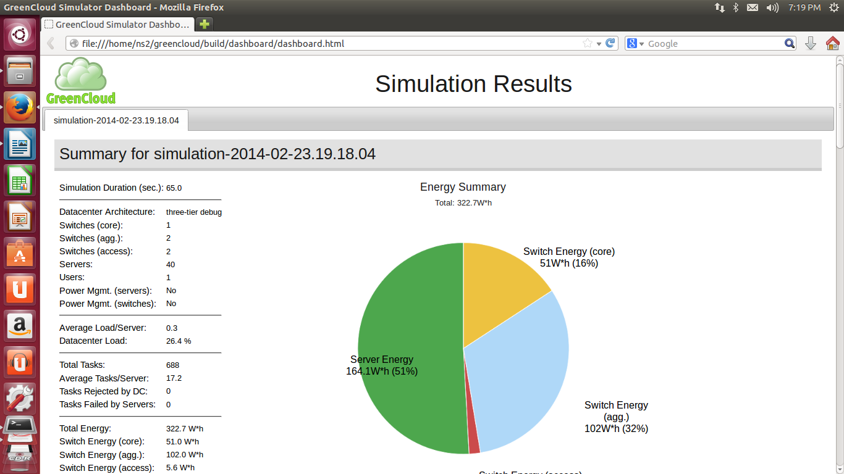
Green Cloud Simulator : A promising alternative
Greencloud is a sophisticated packet-level simulator for energy-aware cloud computing data centers with a focus on cloud communications
It offers a detailed fine-grained modeling of the energy consumed by the data center IT equipment, such as computing servers, network switches, and communication links

Slide 12
Conclusion:
To ensure that cloud computing is optimized to produce the maximum possible output while consuming low energy , we will need to understand and analyse the existing data centre power and cooling designs , power consumption by the servers and their cooling requirements to achieve maximum efficiency
We will also require modelling tools to measure the energy usage of all the components and services of cloud

Slide 13
References:
https://www.techtarget.com/searchstorage/definition/green-cloud
https://www.parallels.com/blogs/ras/what-is-green-cloud-computing/
https://aws.amazon.com/
https://www.investopedia.com/terms/c/cloud-computing.asp
https://www.ibm.com/cloud/learn/cloud-computing
https://carbometrix.com/
Berl, A., Gelenbe, E., Di Girolamo, M., Giuliani, G., De Meer, H., Dang, M. and Pentikousis, K. Energy-efficient cloud computing. The Computer Journal, 53, 7 2010), 1045
M. N. Hulkury, M. R. Doomun, Integrated Green Cloud Computing Architecture , International Conference on Advanced Computer Science Applications and Technologies, ACSAT 2012

